Slide 1
Support Vector Machine

Slide 2
Content to be covered
Basic Introduction
Types of SVM
Basic linear algebra
Hyper-plane
Example of Linear SVM
Optimal Hyperplane
How to choose optimal Hyperplane ?
What if data points is not linearly separable ?

Slide 3
Basic Introduction
Supervised Machine Learning Algorithm
Used for both regression and classification problems
The objective of the support vector machine algorithm is to find a hyperplane in an N-dimensional space(N — the number of features) that distinctly classifies the data points.
Dimension of hyperplane depends upon the number of input features.
SVM algorithm can be used for Face detection, image classification, text categorization, etc.

Slide 4
Types of SVM
Linear SVM: Linear SVM is used for linearly separable data, which means if a dataset can be classified into two classes by using a single straight line, then such data is termed as linearly separable data, and classifier is used called as Linear SVM classifier.
Non-linear SVM: Non-Linear SVM is used for non-linearly separated data, which means if a dataset cannot be classified by using a straight line, then such data is termed as non-linear data and classifier used is called as Non-linear SVM classifier.

Slide 5
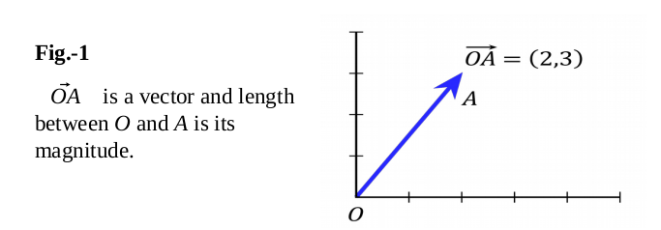
Basic Algebra
Vectors are mathematical quantity which has both magnitude and direction. A point in the 2D plane can be represented as a vector between origin and the point.

Slide 6
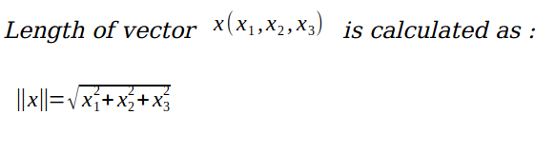
Basic Algebra
Length of vectors are also called as norms. It tells how far vectors are from the origin.
Direction of vector:

Slide 7
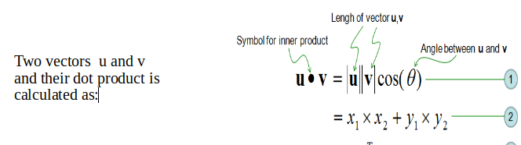
Basic Algebra
Dot product between two vectors is a scalar quantity . It tells how to vectors are related.

Slide 8
Hyperplane
Hyper-plane: It is plane that linearly divide the n-dimensional data points in two component. In case of 2D, hyperplane is line, in case of 3D it is plane.It is also called as n-dimensional line.
The distance between the vectors and the hyperplane is called as margin. And the goal of SVM is to maximize this margin.
In SVM our goal is to choose an optimal hyperplane which maximizes the margin.
The hyperplane with maximum margin is called the optimal hyperplane.

Slide 9
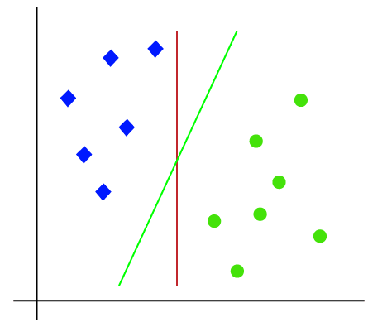
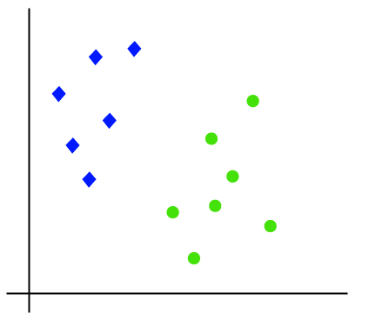
Example of Linear SVM
Suppose we have a dataset that has two tags (green and blue), and the dataset has two features x1 and x2. We want a classifier that can classify the pair(x1, x2) of coordinates in either green or blue. As it is 2-d space so by just using a straight line, we can easily separate these two classes. But there can be multiple lines that can separate these classes.

Slide 10
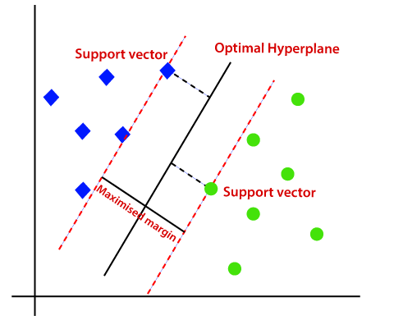
Choosing Optimal SVM

Slide 11
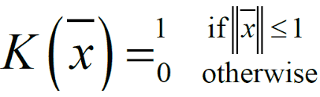
What if the data is non-linear?
Kernel function is used to handle non linear data.
It takes low dimensional feature space as input and give output in the form of high dimensional feature space.
The input we give to kernel function is non linear separable data and when kernel gives this data as output then it becomes linearly separable data.

Slide 12
Types of kernel
Linear Kernel
Polynomial Kernel
Radial/Gaussian Basis kernel function
Sigmoid Kernel

